Slide 1
Adjoint model basics
Daniel Holdaway
JCSDA / NASA Global Modeling and Assimilation Office
JCSDA 2018 Summer Colloquium
Tuesday July 24th

Slide 2
Introduction
In data assimilation we’re essentially performing a balancing between two pieces of information: the previous forecast and the observations. It produces a new ‘best guess’ of the current atmospheric state x₀ by minimizing a cost function:
Forecast x_{b}
Observations
y_{k}
+ | Whole atmosphere
+ | Dynamically balanced
- | Error details not well known.
+ | Small, well described errors.
- | Under representative ~150/1.
Using its gradient:
The adjoint makes it a minimization in a ‘4D’ space.
Notes:
!Adjoint!

Slide 3
Introduction
What is the adjoint?
It's a version of a model that propagates gradients of model variables (sensitivity) backwards in time.
Why do we need adjoint models?
4DVAR data assimilation.
Observation impact calculations (Ron Gelaro talk next week).
Sensitivity studies.
Singular vector calculations.
To gain understand of the underlying model.
Training of neural networks using back propagation.

Slide 4
Outline
Introduction
Derivation of the linearized model
How to write an adjoint model
Validation of the linearized model
Practical issues
Sensitivity examples
Optimal perturbations

Slide 5
Derivation of the linearized model
We have a, most likely, nonlinear model,
where x and y are discrete model variables at an old and new time. From a DA perspective we regularly find ourselves asking a couple of questions:
How does y_{i} change with respect to x_{j}? If we make perturbations to x_{j} how do they affect y_{i}? Suppose x_{j} has some error. How does that error grow?
We’re analyzing something about y_{i} . This could be a forecast bust or just some interesting physical behavior. What specifically was it about x_{j} that led to this?

Slide 6
Derivation of the linearized model
We’re trying to get a handle on perturbations so we ‘linearize’ model variables by separating into reference and perturbation parts,
The output perturbation can be approximated by Taylor expansion,
The above equation is the tangent linear model (TLM) and gives an approximation for the growth of perturbations xj′.

Slide 7
Derivation of the linearized model

Slide 8
Derivation of the linearized model
We’re trying to get a handle on perturbations so we ‘linearize’ model variables by separating into reference and perturbation parts,
The output perturbation can be approximated by Taylor expansion,
The above equation is the tangent linear model (TLM) and gives an approximation for the growth of perturbations x_{j}′.

Slide 9
Derivation of the linearized model

Slide 10
Derivation of the linearized model
The TLM is a useful tool but it doesn’t help us with our second question. To get somewhere towards doing so we first simplify things by introducing a scalar measure of the outputs, .
Using the Taylor series again,
or,
The two estimates are equivalent when both functions are linear.

Slide 11
Derivation of the linearized model
The latter equation is of greater interest since it depends on the model’s inputs, rather than outputs. Since J is a function of a function we can use the chain rule to
differentiate,
Notice how powerful this equation is on its own. Even before using it to estimate J′ we can integrate a forecast time gradient (sensitivity) back to beginning time.

Slide 12
TLM vs. adjoint
Let’s adopt a vector notation to compute all grid points. First a matrix for the gradients:
Now the TLM can be rewritten:
For the TLM we sum over the columns while for the J’ model we sum over rows. To use the vector notation the matrix is transposed (also known as the adjoint),

Slide 13
TLM vs. adjoint
The matrix M is known as the resolvent of the TLM or Jacobian of the nonlinear model. The model which maps sensitivities backwards is known as the adjoint model because it uses the adjoint of the TLM. Note that although they share the operator the physical behavior of the TLM and adjoint is different.
Jointly the TLM and adjoint are frequently referred to as the linearized model.

Slide 14
TLM vs. adjoint
Both the TLM and adjoint depend on the model gradient. They pick out the structures that evolve along the steepest gradients, either forwards or backwards.
The tangent linear model maps a specific perturbation onto all forecast aspects. This allows us to investigate the first question we posed.
The adjoint maps a specific sensitivity backwards with respect to all possible perturbations. This allows us to investigate the second question.
The adjoint is generally more useful but the TLM plays a crucial role in validating the linearized model and is needed for incremental 4D-Var like that run by ECMWF.

Slide 15
Assumptions being made
All of this is based on the Taylor series expansion. So what assumptions have we actually made?
The Taylor series is a good approximation when |x′| is ‘small’.
The nonlinear model is continuous and is differentiable.
However for most modern atmospheric models this is not the case:
In actual applications x′ can be large, e.g. the specific humidity analysis increment and errors can be of the order of 100%.
Unresolved processes are not represented with continuous equations.
Adjoint development means validating the extent to which these assumptions hold true.

Slide 16
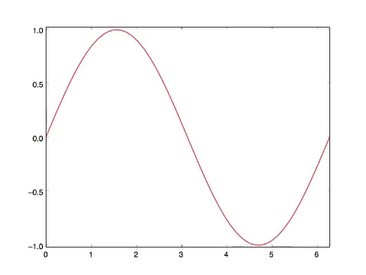
Interpretation of adjoint fields
Sine wave advected with first order scheme

Slide 17
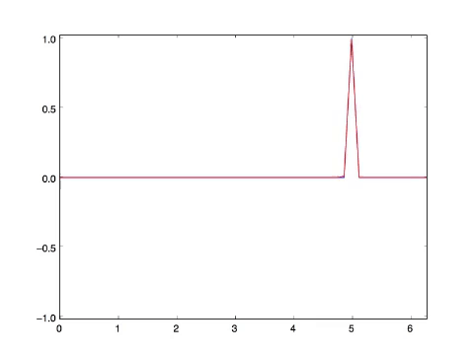
Interpretation of adjoint fields
Sine wave advected with first order scheme
Adjoint initialized with point.

Slide 18
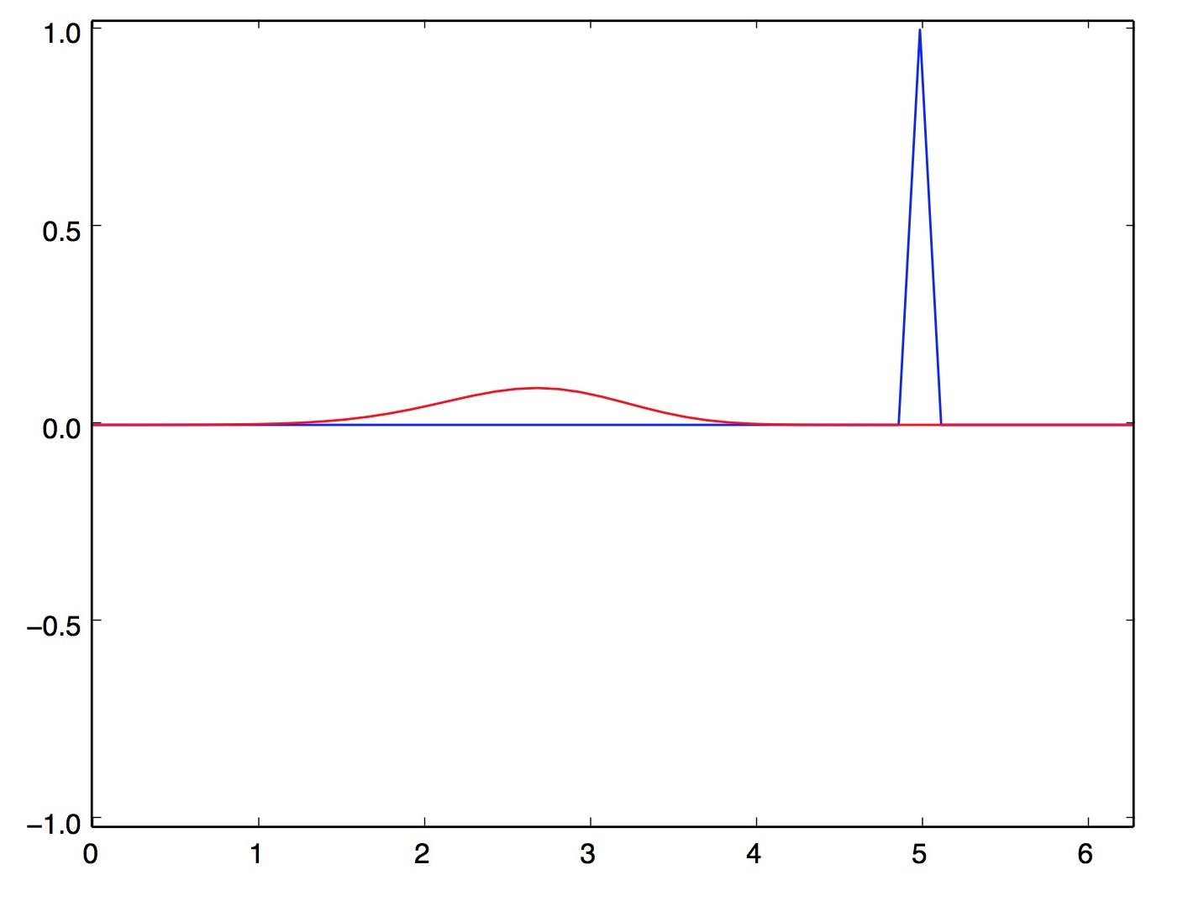
Interpretation of adjoint fields
You could think of the initial condition here as an error, say a missing cloud.
Through the adjoint we learn where the initial condition needs to be adjusted to reduce the difference between the forecast and observation.
In 4D-Var the adjoint is used in this way but for all observations simultaneously and balanced by covariance matrices.

Slide 19
Outline
Introduction
Derivation of the linearized model
How to write an adjoint model
Validation of the linearized model
Practical issues
Sensitivity examples
Optimal perturbations

Slide 20
1D advection example
One dimensional advection of a tracer
The important variables are u and q. Linearize by splitting into e.g.
Eliminate all terms not including one perturbation term,
Continuous TLM

Slide 21
1D advection example (in practice)
Typically we are working with a model that has been discretized, e.g.:
Split the key variables into sum of reference and perturbation parts.
Discrete TLM

Slide 22
1D advection example matrix form

Slide 23
The nonlinear model program
subroutine FirstOrderAdvection(qr,ur,dx,dt,Nx,Nt)
implicit none
argument definitions
qnewr = 0.0
do n = 1,Nt
do j = 1,Nx
if (j .eq. 1) then
qnewr(1) = qr(1) - ur(j)*dt/dx*(qr(1) - qr(Nx))
else
qnewr(j) = qr(j) - ur(j)*dt/dx*(qr(j) - qr(j-1))
endif
enddo
enddo
qr = qnewr aenddo
end subroutine

Slide 24
TLM code example
subroutine FirstOrderAdvectionTLM(qr,ur,qp,up,dx,dt,Nx,Nt)
...declarations...
do n = 1,Nt
do j = 1,Nx
if (j .eq. 1) then
qnewr(1) = qr(1) - ur(j)*dt/dx*(qr(1) - qr(Nx))
qnewp(1) = qp(1) - dt/dx*( ur(1)*(qp(1) - qp(Nx)) &
+ up(1)*(qr(1) - qr(Nx)) )
else
qnewr(j) = qr(j) - ur(j)*dt/dx*(qr(j) - qr(j-1))
qnewp(j) = qp(j) - dt/dx*( ur(j)*(qp(j) - qp(j-1)) &
+ up(j)*(qr(j) - qr(j-1)) )
endif
enddo
qp = qnewp
enddo
end subroutine
q(j) = qr (j) + qp(j)
This code is correct but coding the TLM this way is a mistake!

Slide 25
TLM code example
Order is often important!
qnewr(j) = qr(j) - ur(j)*dt/dx*(qr(j)-qr(j-1))
qnewp(j) = qp(j) - dt/dx*(ur(j)*(qp(j)-qp(j-1)) + up(j)*(qr(j)-qr(j-1)))
Should be written as ...
qnewp(j) = qp(j) - dt/dx*(ur(j)*(qp(j)-qp(j-1)) + up(j)*(qr(j)-qr(j-1)))
qnewr(j) = qr(j) - ur(j)*dt/dx*(qr(j)-qr(j-1))

Slide 26
Guidelines for coding adjoint models
Create a copy of the TLM module.
Remove all non-perturbation lines.
Reverse the order of everything (including reversing loops).
For each line:
For every perturbation variable that occurs on the RHS make a new line with that variable on the LHS
Set it equal to itself with a plus, e.g. qp(j) = qp(j) +
Include the original LHS variable and multiply by the coefficient of the original RHS variable, e.g. qp(j) = qp(j) + qnewp(j) ∗ (−ur(j) ∗ dx/dt)
If a variable is overwritten do not add to itself.
Order is crucial!
To know whether a variable needs to be accumulated think about whether setting it to zero in the TLM would change the result.
Don’t start building the adjoint until the TLM is built and tested!

Slide 27
Adjoint code example
subroutine FirstOrderAdvectionADM(qr,ur,qp,up,dx,dt,Nx,Nt)
...declarations...
do n = Nt,1,-1
qnewp = qp
do j = Nx,1,-1
if (j .ne. 1) then
qp(j) = qp(j) + (1 - dt/dx*ur(j)) * qnewp(j)
qp(j - 1) = qp(j - 1) + dt/dx*ur(j) * qnewp(j)
up(j) = up(j) + dt/dx*(qr(j) - qr(j-1))*qnewp(j)
qnewp(j) = 0
else
qp(1) = qp(1) + (1 - dt/dx*ur(1)) * qnewp(1)
qp(Nx) = qp(Nx) + dt/dx*ur(1) * qnewp(1)
up(1) = up(j) + dt/dx*(qr(1) - qr(Nx))*qnewp(1)
qnewp(1) = 0
endif
enddo
enddo
end subroutine
Checkpointing
The adjoint calculation is performed in reverse. But it relies on a linearization about a state that is computed going forward.
How do we get qr(j)?

Slide 28
Adjoint: check-pointing vs re-calculation
Check-point the trajectory (increases memory use).
STEP1 First run though nonlinear code
saving what you later need:
do n = 1,Nt
qtraj(n,:) = qr
utraj(n,:) = ur
do j = 1,Nx
...
enddo
enddo
STEP2 As you integrate the adjoint read back in:
do n = Nt,1,-1
qr = qtraj(n,:)
ur = utraj(n,:)
do j = Nx,1,-1
...
enddo
enddo

Slide 29
Adjoint: check-pointing vs re-calculation
Forward sweep
MEMORY FOOTPRINT
Backward sweep

Slide 30
Adjoint: check-pointing vs re-calculation
Re-compute the trajectory within adjoint loop (increases computational time):
subroutine FirstOrderAdvectionADM(qr,ur,qp,up,dx,dt,Nx,Nt)
...declarations...
do n = Nt,1,-1
do n1 = 1,n
do j = 1,Nx
...
enddo
enddo
do j = Nx,1,-1
...
enddo
enddo
end subroutine
For complex models you need a combination of these two techniques.

Slide 31
Adjoint: check-pointing vs re-calculation
Forward sweep 1
Forward sweep 2
Forward sweep 3
‘Nt+1 choose 2’ forward steps.

Slide 32
Auto-differentiation
Coding adjoints by hand is error prone and time consuming, especially for today’s complex NWP models. Thankfully there are lots of great tools available to help.
Tapenade (http://tapenade.inria.fr:8080/tapenade/)
Taf (http://www.fastopt.de/)
OpenAD
Pass them a subroutine and they return TLM and ADM. Some considerations though:
Code not usually the most efficient it can be.
They cannot tell you if you should differentiate (next section).
Tools have different characteristics.

Slide 33
Outline
Introduction
Derivation of the linearized model
How to write an adjoint model
Validation of the linearized model
Practical issues
Sensitivity examples
Optimal perturbations

Slide 34
Validation of the TLM
It is crucial to validate the linearized model carefully when developing code. This is formally done using the TLM and verifying that,
But really what we want to look at is:
for realistic x′ and across a range of metrics e.g. root mean squared error and the root mean square of each.

Slide 35
Strong versus weak nonlinearity
Note that
will actually fail for most modern atmospheric models that include physics, even if the TLM is coded correctly. This is because of the discrete switches in the code while this formal test assumes a continuous model, actually = .
Weakly nonlinear: the model is continuous but contains products of perturbation terms, the above test passes. E.g. the Navier-Stokes equations.
Strongly nonlinear: the model is not continuous, first derivatives do not necessarily exist, the above test is misleading. E.g. precipitation activated for a relative humidity threshold.

Slide 36
Validation of the TLM

Slide 37
Validation of the adjoint
Once you are happy with the TLM performance, the correct coding of the adjoint is confirmed using a dot product test.
The result wont generally be zero but something on the order allowed by
precision.
For double precision:
For single precision:
If the result is larger than this there exists a bug somewhere.

Slide 38
Validation for sensitivity studies
Recall that the adjoint is actually initialized from some J function and that should be included in any application checks.
This is done by comparing the nonlinear J′ with the linearized approximation.

Slide 39
Outline
Introduction
Derivation of the linearized model
How to write an adjoint model
Validation of the linearized model
Practical issues
Sensitivity examples
Optimal perturbations

Slide 40
Real World example of an issue
Consider the linear 1D advection problem again,
Linearized and with constant wind, u′ = 0,
The problem is exactly linear. So long as we choose a linear scheme then whatever perturbation we choose the linearization is exact

Slide 41
Advection of the reference part
In these runs a top-hat profile is advected once around the domain with a selection of horizontal differentiation schemes.
These schemes are all linear except the limited PPM scheme, as used in GEOS.

Slide 42
Advection of a perturbation
Now a point perturbation is applied to the top-hat at the initial time and the advection is done again.
Blue curves show the difference between two nonlinear runs. The red curve shows the TLM.

Slide 43
Examining TLM stability
When encountering problems one way to examine the behavior is to numerically assemble the Jacobian:
Set x1′ =1 and x2′ =0 and run the TLM model to get,
Repeat, setting each element of x to 1 and running the TLM to obtain the corresponding column of the Jacobian.

Slide 44
Stability analysis
Having the Jacobian lets us examine the gradients of the model directly, which can be very useful.
It also allows for stability analysis,
where ,
are the eigenvalues of .
Eigenvalue spectrum of the limited PPM advection scheme. There is no hope of linearizing this in any kind of meaningful and stable way.

Slide 45
Stability analysis
When we see an eigenvalue spectrum like this it immediately tells us that this scheme should not be linearized, and has saved us the bother of writing the adjoint.
Fortunately, the reasons that linear schemes are not used for advection are not so important when it comes to transporting perturbations and sensitivities.
In this instance the nonlinear model and linearized model will be based on different equations, a so called “perturbation model”.
Note that stability analysis can be less useful for high dimensional problems.

Slide 46
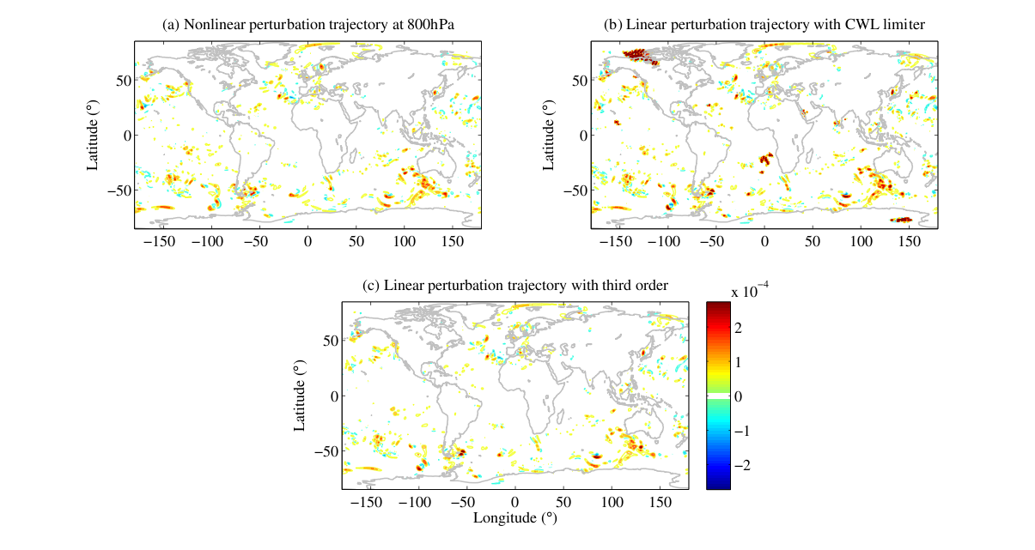
Cloud liquid water perturbation in GEOS

Slide 47
Problems with physics
These issues with advection aren’t due to the equations but the scheme that is chosen.
For the physics the issues are often due to the equations themselves.
Below shows the equation for cloud fraction in GEOS-5,
Nonlinear cloud fraction perturbations are bounded between 0 and 1. The TLM of this part of the model produces cloud fraction perturbations that are O(10³)!

Slide 48
Problems with physics
Now we have to do some analysis and make a decision on how to proceed.
Do we try to find a new way of computing cloud fraction that is more linear and does not support rapid perturbation growth?
or
Do we try to predict and eliminate when situations where the TLM will fail.

Slide 49
1. A new scheme (approach taken by the ECMWF)
Advantages:
The new scheme can be fast and so suited to 4DVAR.
Designed from the ground up means reliable results.
Disadvantages:
Requires lots of cross-discipline interaction.
Tuning new physics schemes is very tedious.
The nonlinear model will have different behavior from the linearized model.

Slide 50
2. Scheme analysis (approach taken by NASA)
Advantages:
Keeps the linearized model close to the nonlinear model.
Allows DA scientists to work independently.
Much faster to develop and redevelop.
We learn much as we go and find bugs.
Disadvantages:
May be slower to run.
Always the chance that you miss something.

Slide 51
3. Do both
Depending on application the ideal situation could be to analyze the behavior but also have an alternative scheme to use when we notice a problem.

Slide 52
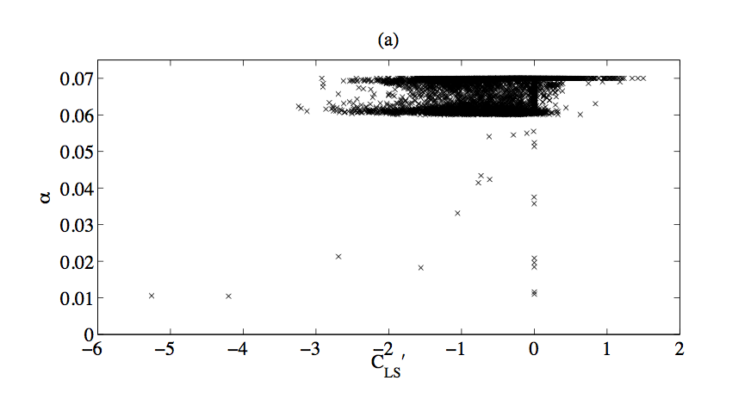
Correlation with trajectory
Start by making plots of the problem perturbation against aspects of the trajectory.
Sometimes this can work incredibly well and give you a way to control problems. It can also speed the code up by limiting the places where the TLM and adjoint are used.
Assume no cloud perts at this cut off for example.

Slide 53
Correlation with trajectory
Sometimes this approach can be used with great success. The linearized convection scheme in GEOS, for example, remains stable by computing a single column of the Jacobian only when the convection is a certain depth and analyzing the magnitude of the elements at three specific model levels. Occasions where the moist physics suffers an instability in the system are extremely rare.
For other schemes you can exhaust all possibilities without finding a useful and efficient approach. In these cases it’s best to implement a perturbation model. However, unlike for advection this typically means inventing something new.

Slide 54
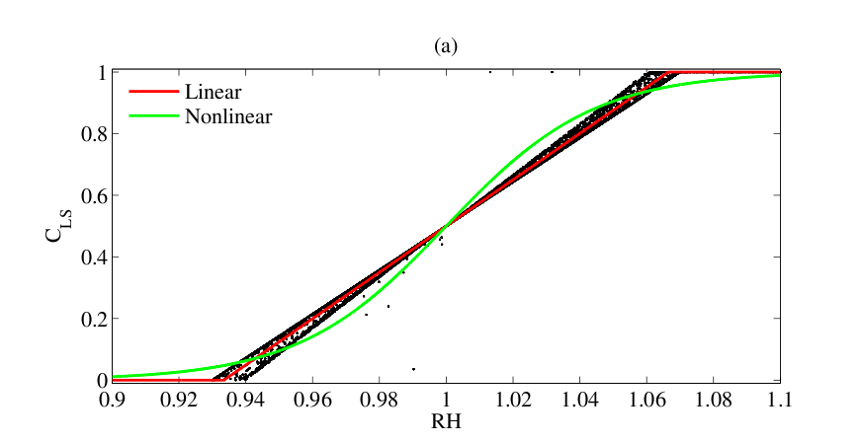
A new model (the simple way)
As complex as the model sometimes seems it is not always the case.

Slide 55
A new model (the simple way)
In this situation we can replace,
With
and get almost the same result for the nonlinear forecast. This function is piecewise linear and we always know the gradient. We simply tune one value until results are satisfactory.

Slide 56
Problems with physics
Most likely no perfect solution is possible so pick the lesser of the multiple evils!
Unrealistically large perturbation growth has to be avoided.
Piecewise linear functions have problems at the switches.
But smoothing introduces ‘development drift’ from the true model.
Learning from adjoint work. It is interesting to look at physics schemes in this way. Use of steep gradients and switches implies a certain confidence in the scheme’s ability to ‘determine’ the cloud fraction. But can it fundamentally achieve that? And should that really be the aim?

Slide 57
Outline
Introduction
Derivation of the linearized model
How to write an adjoint model
Validation of the linearized model
Practical issues
Sensitivity examples
Optimal perturbations

Slide 58
North East blizzard of January 2015
This case presented some interesting forecasting challenges.
Initialize the adjoint with energy, surface pressure or circulation in the box.
Sea level pressure with wind field

Slide 59
North East blizzard of January 2015
Initialize the adjoint with surface pressure and run backwards 36 hours.
Positive means positive sensitivity, i.e. a positive perturbation would increase J.
Increasing moisture in these key regions decreases surface pressure – makes the storm stronger.

Slide 60
Outline
Introduction
Derivation of the linearized model
How to write an adjoint model
Validation of the linearized model
Practical issues
Sensitivity examples
Optimal perturbations

Slide 61
Optimal perturbations
The general idea is that we want to maximize,
subject to a constraint, chosen as,
Could also minimize C subject to J′. This is Lagrange multiplier problem, which has the solution,

Slide 62
Optimal perturbations
Effectively we look for the location where gradient vectors of the function and the condition are parallel by differentiating I and setting equal to 0.
The optimal perturbation is,
The constant λ results from the two parallel gradients generally having different magnitudes. It is calculated by plugging x_{j}′ back into the constraint. The weights w_{j} are required to account for uneven grid spacing and mass changes with height.

Slide 63
North East blizzard optimal perturbation
Now the units and magnitudes of the fields are more realistic and can be propagated the nonlinear model. This reveals how uncertainty with with this structure would behave.
The structures are also evolved with the TLM to validate the experiment.

Slide 64
SLP difference after optimal perturbation
With these optimal perturbations the storm is drastically weakened and the track shifts, moving the storm away from the coast much faster.

Slide 65
Conclusions
The adjoint and TLM are very useful tools, used in a wide variety of applications, as we’ll see this week.
The derivation uses relatively straightforward principles but developing adjoint models in non-trivial. Adjoint models are rarely of the full nonlinear model but some “PF” model.
Development can be tedious but automatic tools can help significantly.
Care is required to understand the underlying behavior of the model but this in itself is very useful and we learn a lot. There are lots of tools for looking at behavior.
Looking at adjoint sensitivity can provide basic understanding of atmospheric behavior as well as informing us how to improve data assimilation.

